Slide 1


School of Computational Techniques for Physics Students in Kenya
Nairobi - 18/06/2024
Introduction to machine learning
Lorenzo Capriotti
Università di Ferrara and INFN Ferrara

Slide 2
Outline
Introduction to the experimental data and methodology
Principal Component Analysis of NIR absorbance spectrum of milk
Particle detectors and particle physics experiment workflow
Event selection in particle physics: signal isolation and background rejection
Multivariate selections and machine learning algorithms

Slide 3
Analysis of the NIR absorbance spectrum of milk

Slide 4
Analysis of the NIR absorbance spectrum of milk
Near-Infrared (NIR) spectral data from milk samples with varying concentrations of lactose.
The samples were prepared by mixing normal milk with lactose-free milk in different proportions. We have 8 different samples, 50 measurements per sample
The NIR scan was obtained with 601 different wavelengths
Many data points but high correlation
Level of information is poor
Solution: Principal Component Analysis (PCA)
PCA will reduce the dimensionality of the problem from 601 to 2 or 3
Analyzing NIR spectroscopy data requires a crucial step: calculating the first derivative

Slide 5
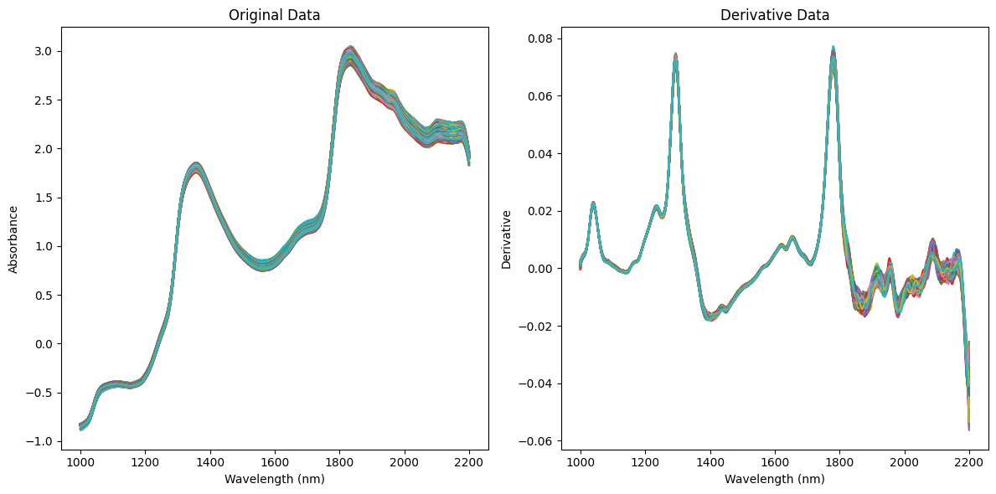
Analysis of the NIR absorbance spectrum of milk

Slide 6
Analysis of the NIR absorbance spectrum of milk
The calculation of the first derivative corrects for baseline variations between scans, emphasizing the key differences in the data, although it also amplifies the noise in the data

Slide 7
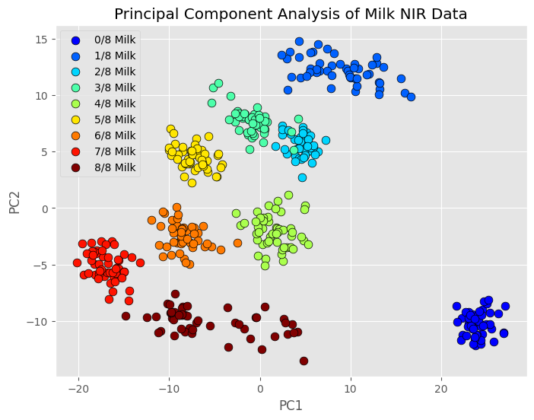
First two Principal Components

Slide 8
First two Principal Components

Slide 9
First two Principal Components

Slide 10
First two Principal Components

Slide 11
Particle detectors and experimental workflow

Slide 12
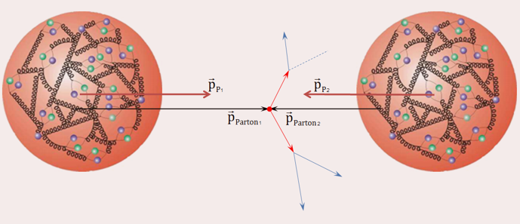
Proton-proton collisions at the LHC
New particles
New particles
Energy of each proton: 7 TeV
Energy of centre of mass: 14 TeV
Each parton carries a fraction of it
according to specific probability distributions
Primary interaction vertex (PV)

Slide 13
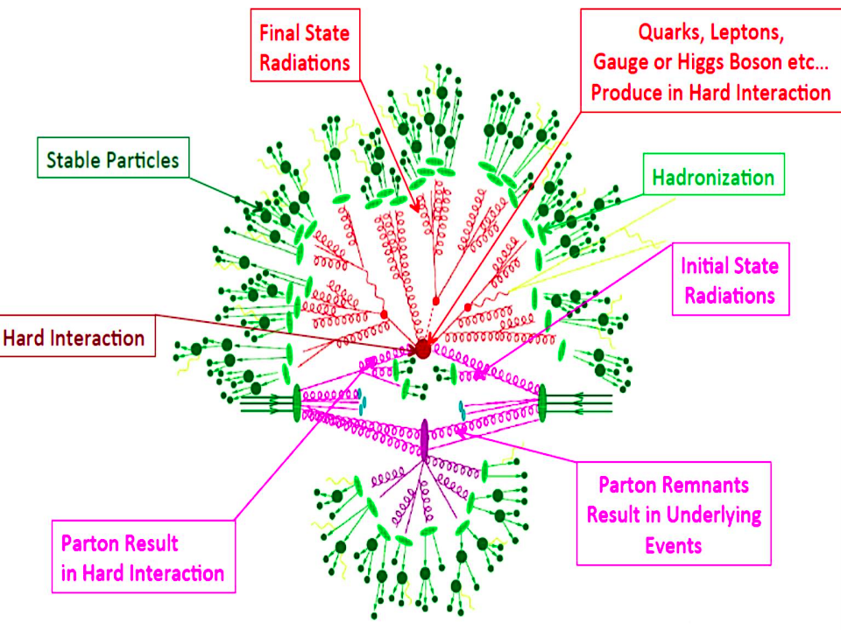
Proton-proton collisions at the LHC

Slide 14
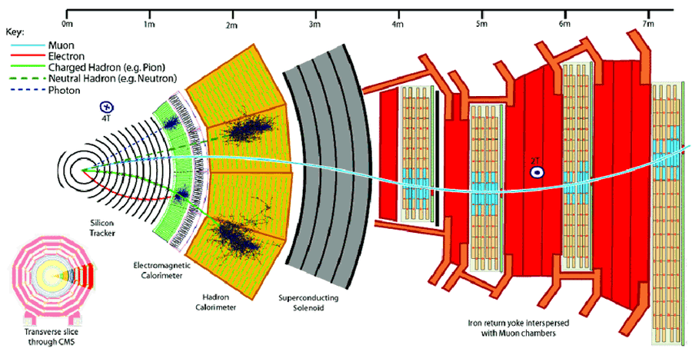
Particle detectors

Slide 15
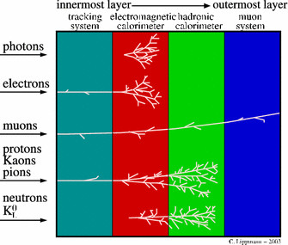
Particle detectors
General overview of a HEP detector
Several layers made with different materials, electronics, readout
Each of them with a different goal
Different particle species interact with the materials differently
They all leave hits in the detector
From hits we reconstruct tracks

Slide 16
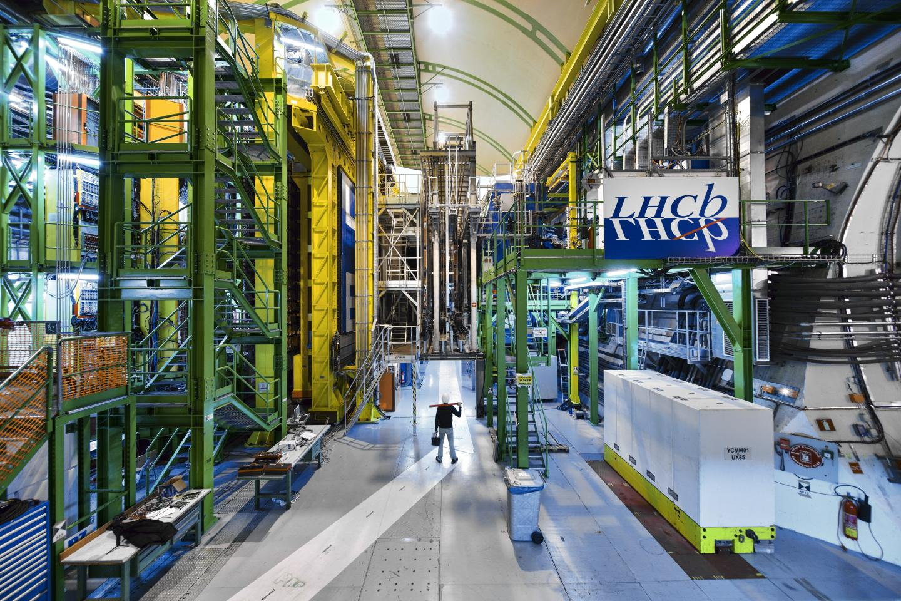

Slide 17
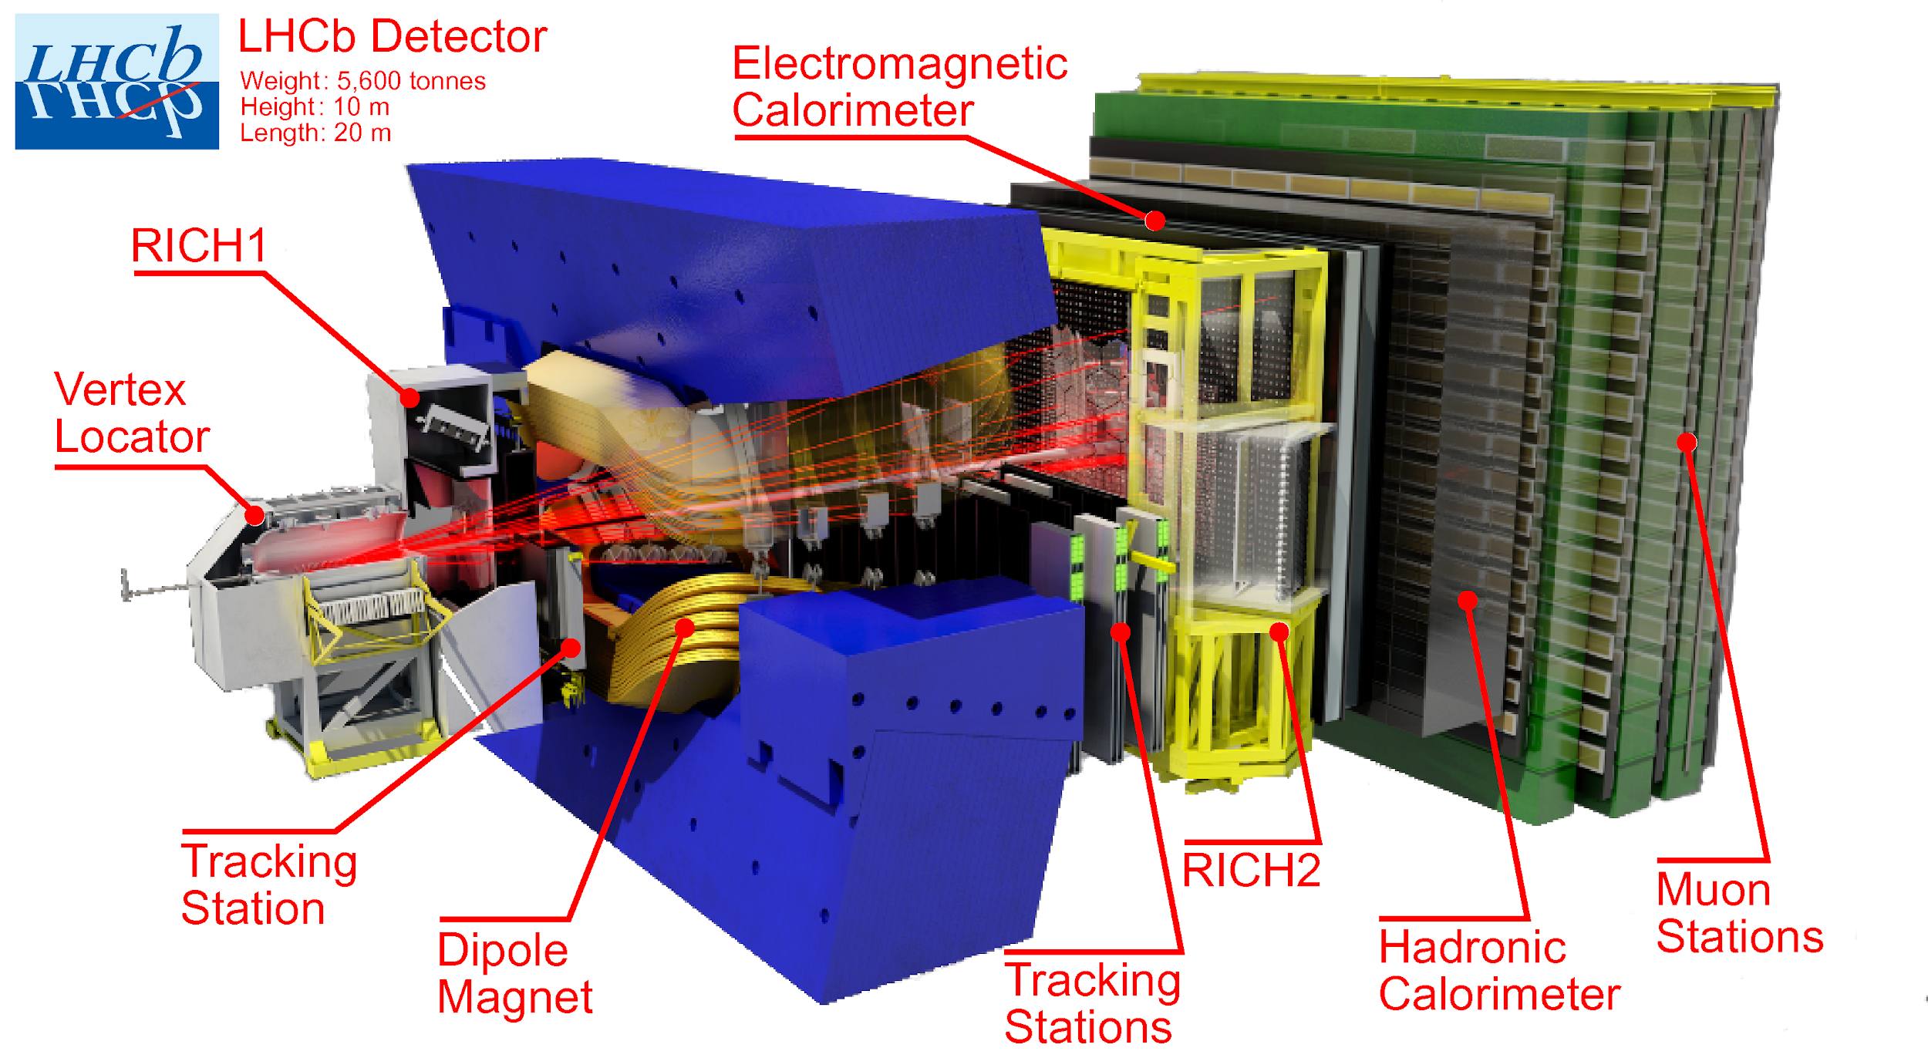
The LHCb detector at CERN

Slide 18
Topological structure of an event
proton
proton

Slide 19
Topological structure of an event
Collision + ISR + FSR + hadronisation

Slide 20
Topological structure of an event
Primary Vertex
Tracks outside acceptance are used to measure the PV position and for other calibrations
LHCb geometric acceptance

Slide 21
Topological structure of an event
Primary Vertex
LHCb geometric acceptance

Slide 22
Topological structure of an event
Primary Vertex
Secondary vertex
(or decay vertex)
due to weakly decaying particles
with measurable lifetime

Slide 23
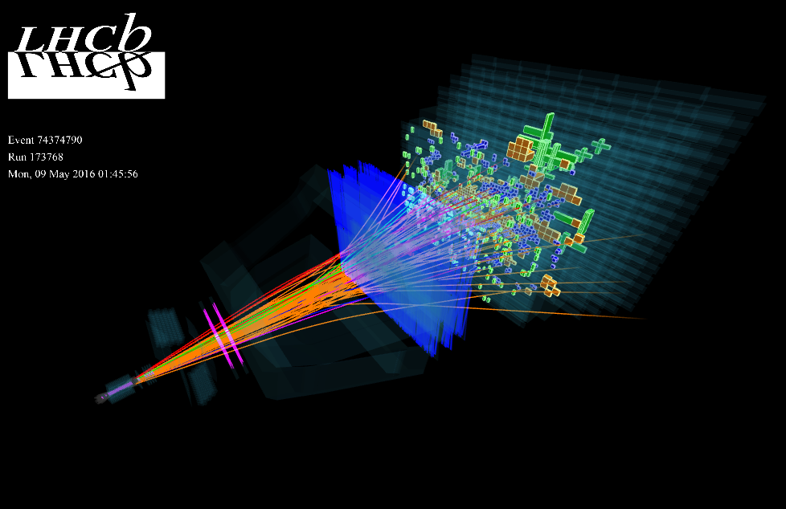
The LHCb detector at CERN

Slide 24
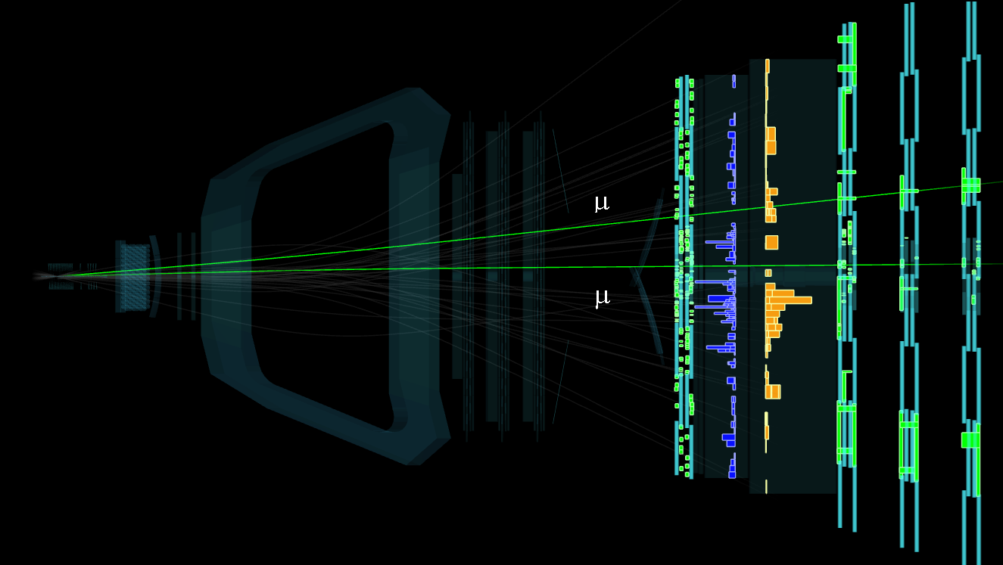
The LHCb detector at CERN

Slide 25
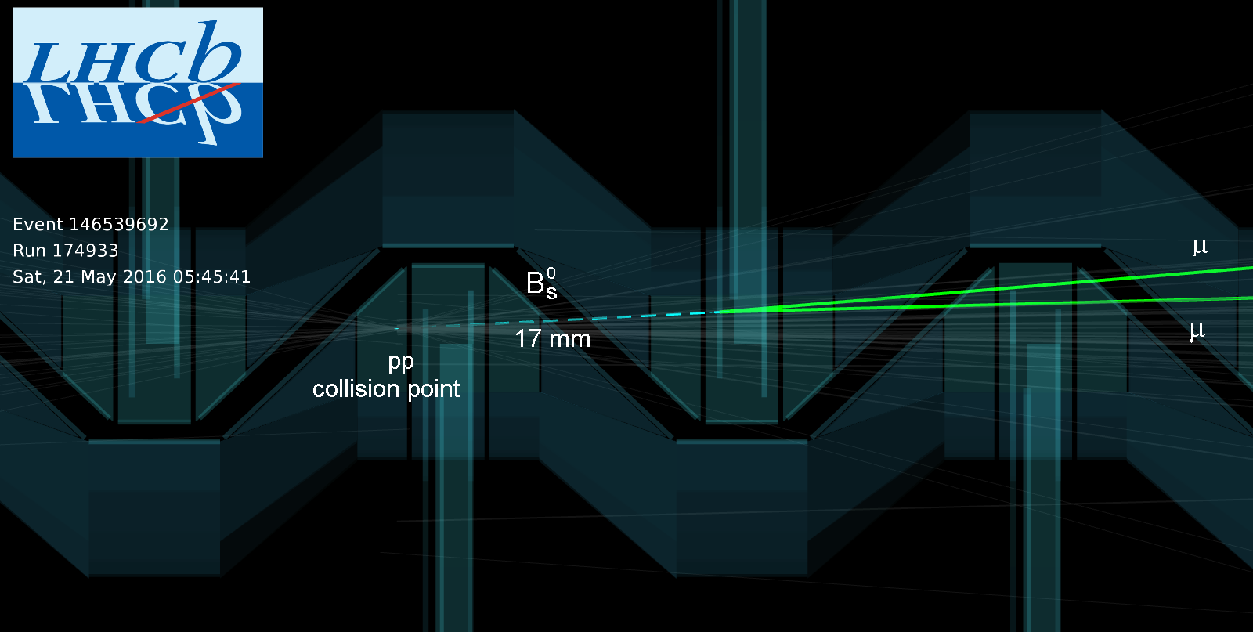
The LHCb detector at CERN
Primary vertex
Secondary vertex (or decay vertex)

Slide 26
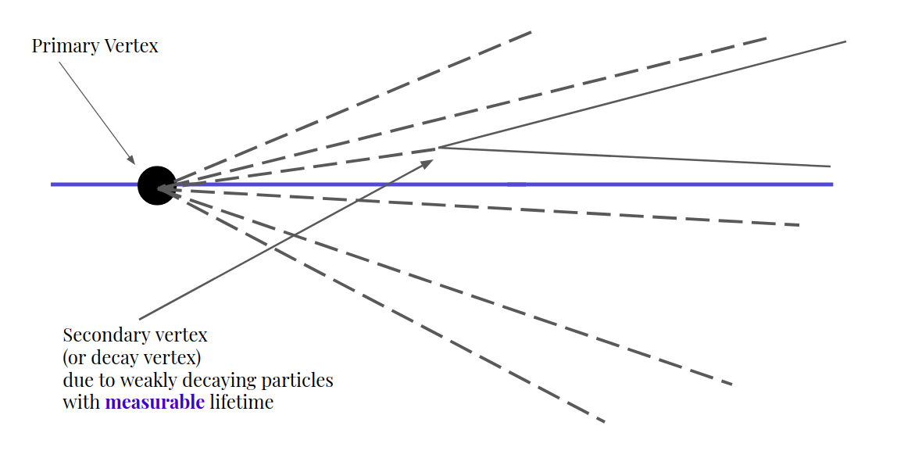
Typical workflow of a HEP experiment
Detector response
Trigger
Tracking algorithms
Objects reconstruction
Clustering algorithms
Storage

Slide 27
Typical workflow of a HEP experiment
Efficiencies
calculation
Parameters
estimation
Detector response
Signal
extraction
Many other
funny things
Trigger
Tracking algorithms
Data analysis
Objects reconstruction
Clustering algorithms
Event selection
Procedure that loops over
all the signal candidates
and decides whether to
accept them or reject them
Storage

Slide 28
Event selection

Slide 29
Signal efficiency and background rejection
Almost all datasets contain an admixture of signal and background which are selected by the trigger. To tell apart the two categories we need to study their characteristics.
Two useful tools are the following:
The signal efficiency of a selection is defined as ε=S_{f}/S₀, where S_{f} is the number of signal candidates after the selection and S₀ is the number of signal candidates before the selection.
The background rejection of a selection is defined as R=(1-B_{f}/B₀), where B_{f} is the number of bkg candidates after the selection and B₀ is the number of bkg candidates before the selection.
S_{f} , S_{o}, and B_{f} , B₀ are counted isolating regions where we have only signal or only background (it can be a simulated dataset - usually for signal - or a sideband - usually for background).
The perfect analysis is the one for which ε=1 and R=1 simultaneously for the full selection.

Slide 30
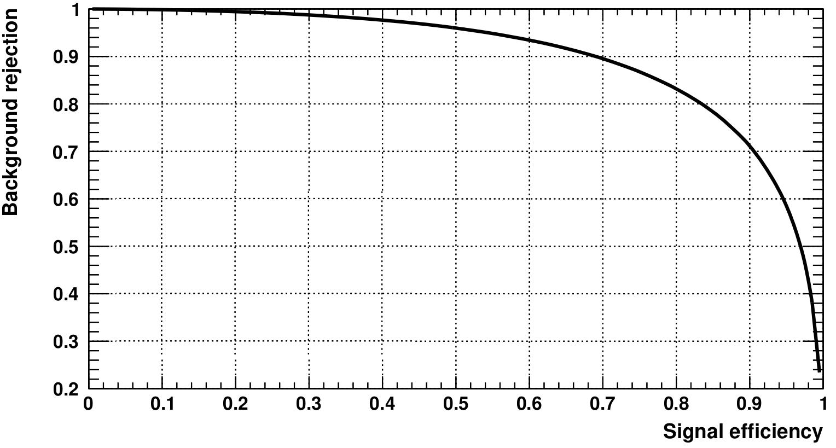
Signal efficiency and background rejection
Of course, sadly the perfect analysis does not exist…
We must always find a compromise
In special cases, one might choose “by eye” to exploit a certain feature
Usually there are better methods to choose the optimal point
They depend mainly on what we are trying to measure

Slide 31
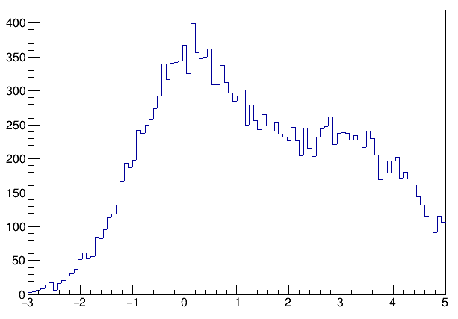
Cut-based selection and cut-flow

Slide 32
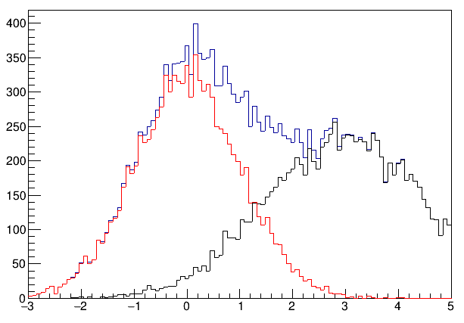
Cut-based selection and cut-flow
Signal
Background
Total

Slide 33
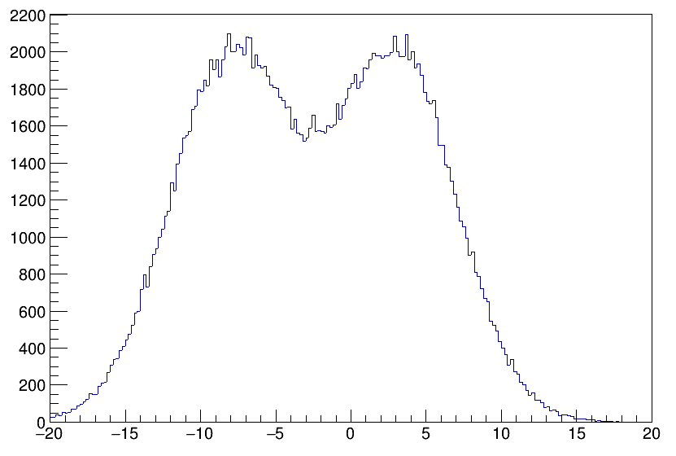
Bidimensional and multivariate selection

Slide 34
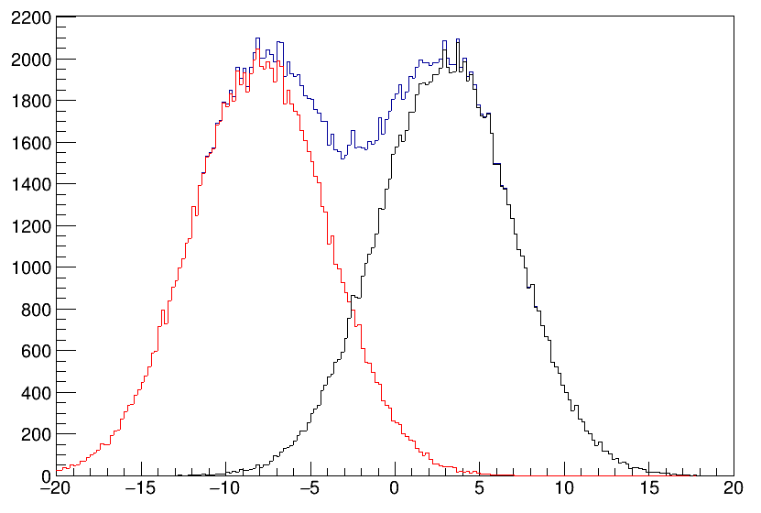
Bidimensional and multivariate selection
Signal
Background
Total

Slide 35
Bidimensional and multivariate selection
Signal
Background
Total

Slide 36
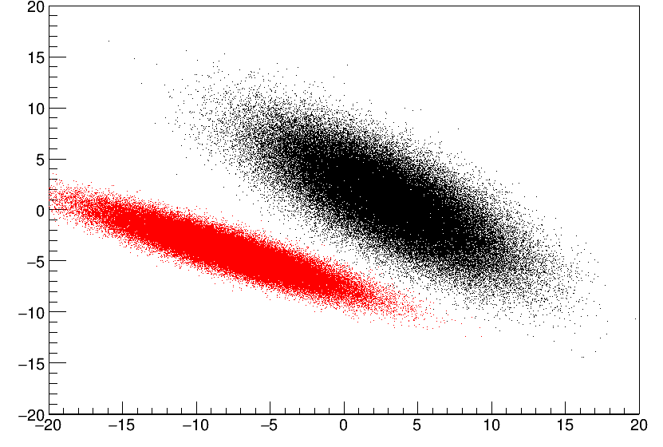
Bidimensional and multivariate selection
Signal
Background

Slide 37
Bidimensional and multivariate selection
Signal
Background

Slide 38
Bidimensional and multivariate selection
In many cases, a cut-based selection is not enough
If we look at the bidimensional histogram of two variables, they might have some correlation that we can exploit
A better selection is a linear combination of the two variables, i.e. a diagonal cut in the 2D plane
…but it could also be a nonlinear combination (a curve in a 2D plane)
In principle, one could extend this to a N-dimensional space…
However, two major problems will ultimately lead to limitations to this method
Non-linear correlations between the discriminating variables
Increasing complexity and large number of combinations of variables

Slide 39
Multivariate classification and machine learning algorithms

Slide 40
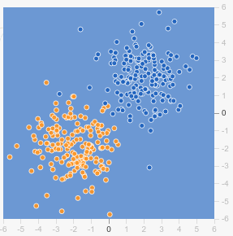
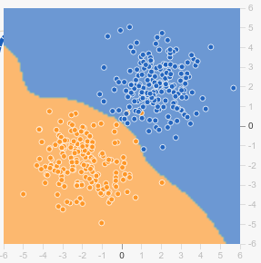
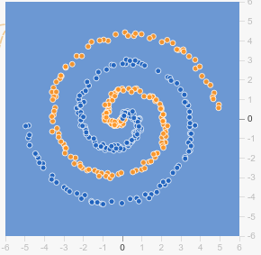
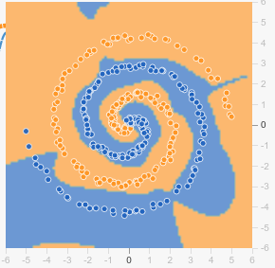
MVA and machine learning algorithms

Slide 41
MVA and machine learning algorithms
Signal proxy
Background proxy
Testing sample
MC dataset
ML training
ML testing
Classification weights
Schematic example of a supervised learning algorithm
Data classification

Slide 42
Example of ML: artificial neural network (ANN)
ANN are inspired by a (simplified) model of neuron cells in the human brain.
The output is computed combining the responses of multiple nodes.
The input nodes are arranged into the input layer and they take the data as input.
The output of the first layer is passed onto the second layer, and so on until the last output layer. All layers between the input and output are called “hidden layers”.
The output of each node is computed as weighted sum of its input variables; the weights themselves are optimised during the training phase of the algorithm.
x₁
w₁₁⁽¹⁾
w₁₁⁽²⁾
w₁₂⁽¹⁾
w₁₁⁽³⁾
x₂
w₁₂⁽²⁾
w₁₁⁽⁴⁾
x₃
w₁₂⁽³⁾
w₂₁⁽⁴⁾
y(x)
x₄
w_{1K}⁽²⁾
w₃₁⁽⁴⁾
w_{1M}⁽³⁾
x₅
w_{1J}⁽¹⁾
x_{N}

Slide 43
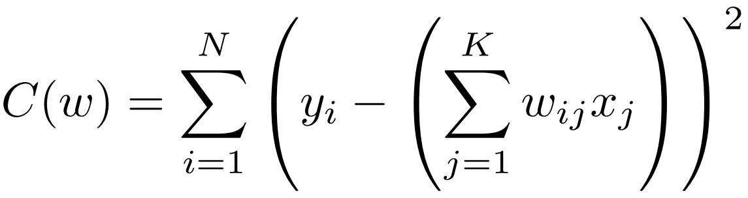
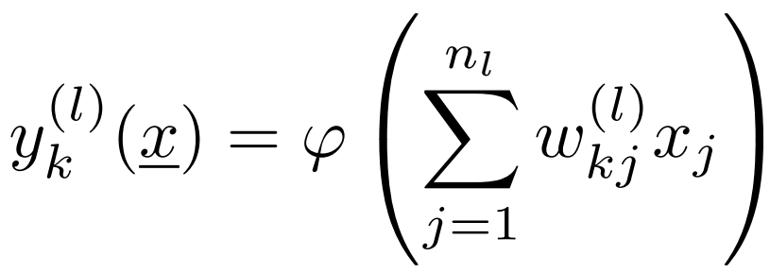
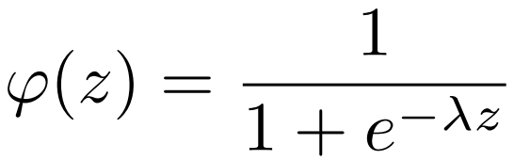
Example of ML: artificial neural network (ANN)
The training is achieved by minimising a loss function to get the weights
and then calculating the output of the k-th node of the l-th layer as
where φ(z) is the node activation function, often taken as a sigmoid:
x₁
w₁₁⁽¹⁾
w₁₁⁽²⁾
w₁₂⁽¹⁾
w₁₁⁽³⁾
x₂
w₁₂⁽²⁾
w₁₁⁽⁴⁾
x₃
w₁₂⁽³⁾
w₂₁⁽⁴⁾
y(x)
x₄
w_{1K}⁽²⁾
w₃₁⁽⁴⁾
w_{1M}⁽³⁾
x₅
w_{1J}⁽¹⁾
x_{N}

Slide 44
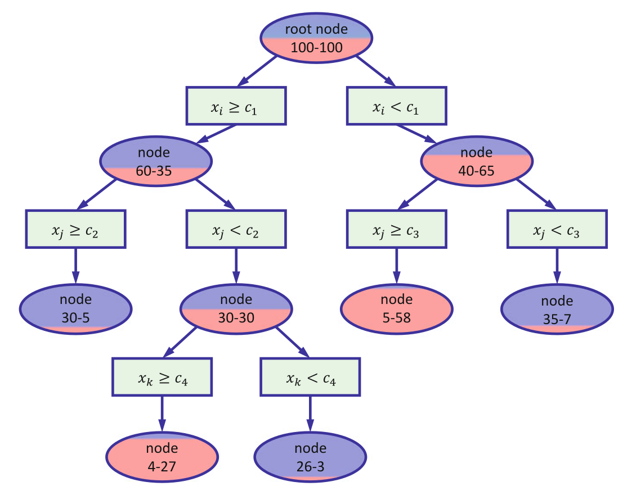
Example of ML: boosted decision tree (BDT)
BDT is one of the most used ML algorithms in HEP (but not necessarily the best)
A decision tree is a subsequent series of cuts on randomly selected variables.
After a certain number of steps, it stops and it classifies the selection as signal S or background B.
The cuts are chosen to minimise loss.
This is an example of weak classifier, as a single tree is basically an automated procedure to apply a series of cuts.
In order to boost the performances we need a higher level of complexity.
Leaf

Slide 45
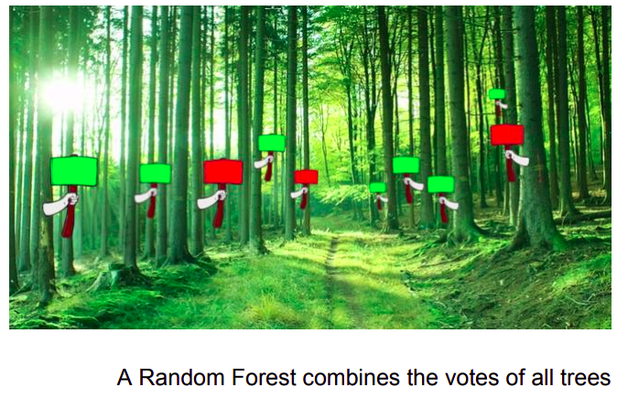
Example of ML: boosted decision tree (BDT)
This is achieved by the so-called Random Forest.
A large number of trees contribute to the final
output. For each input event, the output of all
trees is considered and the final decision is
calculated as the average of the single ones.
We could use the information of a tree into the
training of another tree.
We can, therefore, create a forest by iteratively
adding new trees which are optimised based on
the decisions obtained in the previous iteration.
This procedure is called boosting.

Slide 46
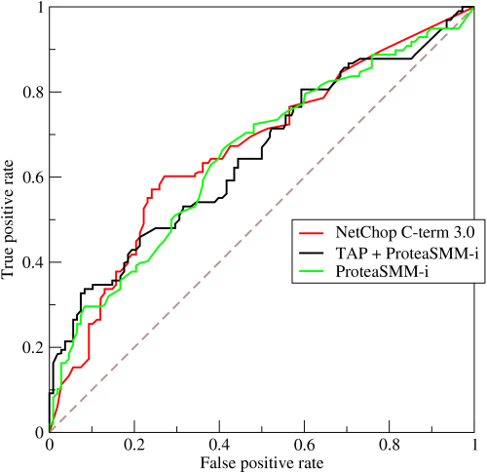
ROC curve and AUC discriminant
The ROC (Receiver Operating Characteristic) curve is a graphical system to assess the quality of a classifier and they are largely used with machine learning algorithms.
Perfect classifier
Random classification
The area under the curve (AUC) is often used as discriminant to select which classifier works best in the specific situation

Slide 47
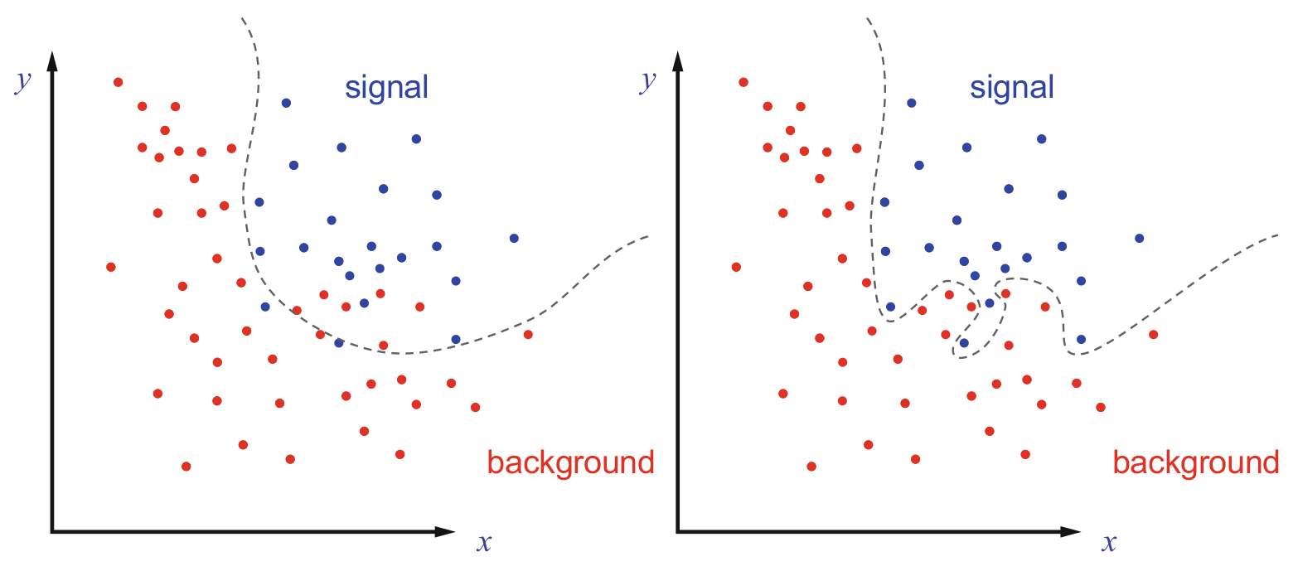
Undertraining and overtraining
Any ML algorithm suffers from two general potential problems:
Undertraining: the size of the training sample is not large enough to properly populate the hyperspace of the input variables, but the algorithm parameters are tuned to reflect this issue. In this case, the algorithm performances will be sub-optimal.
Overtraining: if the parameters of the algorithm are tuned in an inadequate way with respect to the sample size, the training procedure might exploit artificial structures due to statistical fluctuations which are not representative of the expected distributions. This results in a wrong classification of signal and background events.

